Slide 1
The Effects of Income Statistics on GDP
By Group 7

Slide 2

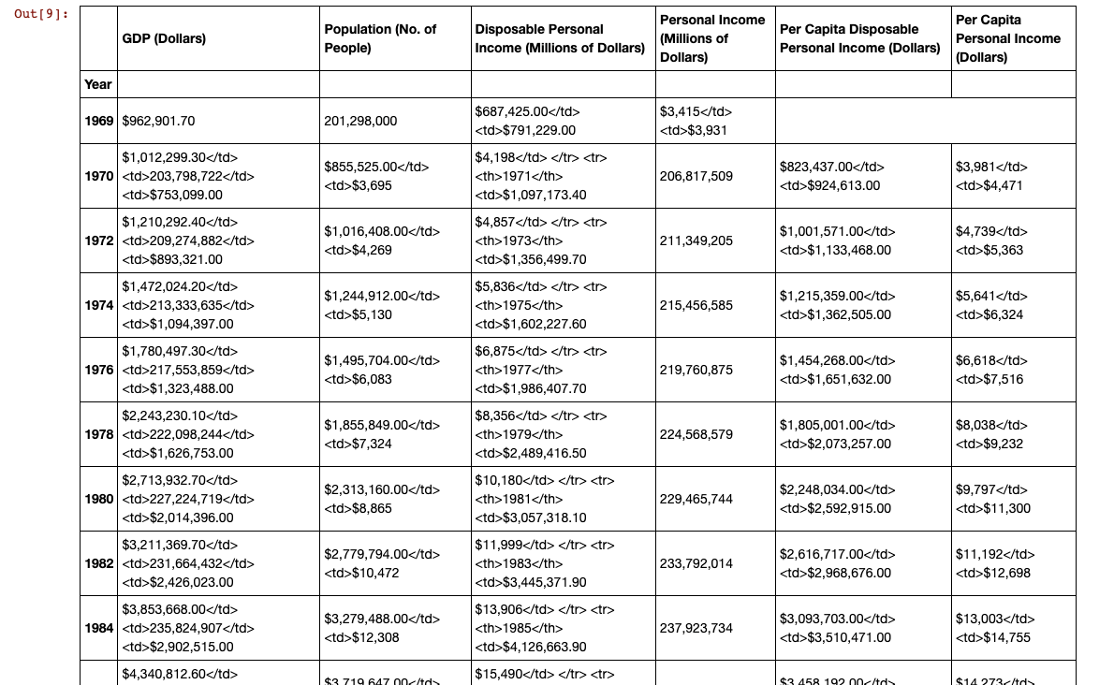
Sourcing the Data: Bureau of Economic Analysis (BEA)
We used bea.gov to source the data for our project.
BEA is an official website of the US government and has accurate and objective data about the nation’s economy.
The data needed was spread out over a couple of different sections and also split by specific date ranges. This is where the skills learned during class were useful.
Using Jupyter Notebook and pandas we were able to load, clean, and combine the data from BEA to fit the outline as agreed by the group.
Notes:
While presenting I could go into a little more detail of what data looked like and the process of manipulating using pandas.

Slide 3
What are these Economic Indicators?
Gross Domestic Product (GDP): This is a consumption indicator that tells us the dollar amount for all the goods and services consumed/completed over a certain period of time.
Personal Income: An individual’s total earnings and can be generated from multiple avenues. This figure reflects the sum of all salaries, dividends, and social benefits.
Disposable Income: The amount of revenue made by a person once the necessary taxes on the income has been paid.
Per Capita: Average per person.

Slide 4
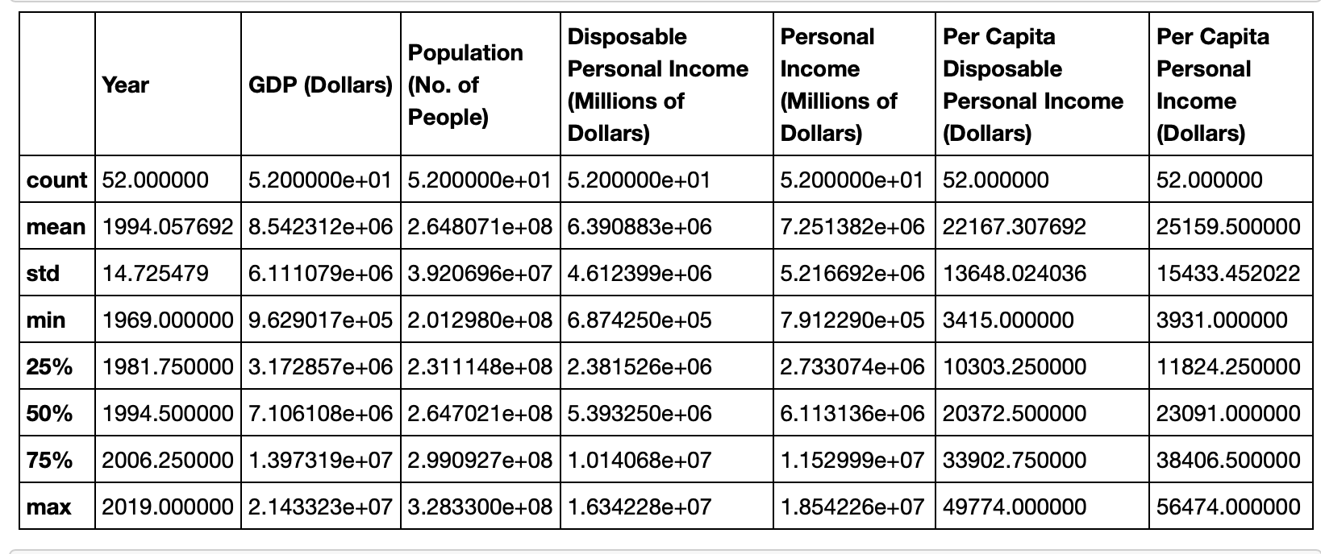
Summary Stats

Slide 5
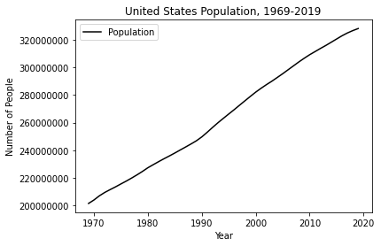

Slide 6
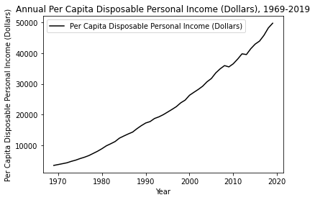

Slide 7
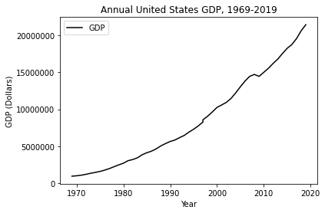

Slide 8
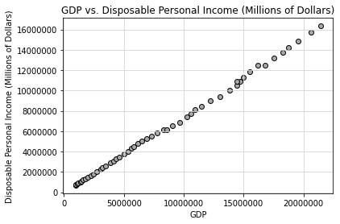

Slide 9
What did we do with this Information?
We created a multivariate linear regression formula trying to explain changes in GDP with only using variables we found in the income information.
A multivariate linear regression model is very similar to the linear regressions we have done in class and follow a similar y=mx+b format.
As the name suggests there are more x variables, so equations looks like this:
Y = m1x1 + m2x2 + m3x3 + … + b
x1, x2, and x3 are independent variables
m1, m2, m3 are the respective slopes for each variable
The term b still denotes the y-intercept

Slide 10
First Regression: Used All Variables
Our first regression looked like this:
GDP = 0.0264(Population) + .5383(Disposable Income) + .7765(Personal Income) - 108.9833(Disposable Income Per Capita) + 2.4156 (Personal Income Per Capita) -5190895.8857
Findings:
Population had the least effect on GPD.
Disposable Income and Personal Income seemed to be more heavily weighted on the Per Capita level rather than the Macro level.
Since our income variables were similar, but the Per Capita variables broke the information down to the individual level we decided to run 2 more regressions each focusing on one type of variable.

Slide 11
Second Regression: Macro Variable Regression
We omitted all Per Capita variables and the model we were left with was:
GDP = .0125(Population) + .3940(Disposable Income) + .7299(Personal Income) - 2590904.4722
Findings:
In this model we see the coefficients of the Population size and Disposable Income decrease.
Personal Income has roughly stayed relatively the same.
Y intercept has become slightly less negative.

Slide 12
Third Regression: Per Capita Variable Regression
Here we reinstated all Per Capita variables and omitted all Macro variables:
GDP = -0.0583(Population) + 500.6322(Disposable Income Per Capita) + 99.3041(Personal Income Per Capita) + 10395012.3497
Findings:
We see the explaining power of the Population variable has increased; however, the coefficient is now negative.
In this model we also see that Disposable Income Per Capita has much more explaining power over GDP than Personal Income Per Capita.
Here we see the y intercept is positive.

Slide 13
Limitations of the Model
The largest limitation of this model is the lack of other types of variables. It is difficult to create an accurate model with only income data.
We would have liked to have included variables such as Inflation and Employment Rate; however, we could not find reputable sources for either.

